Slide 1
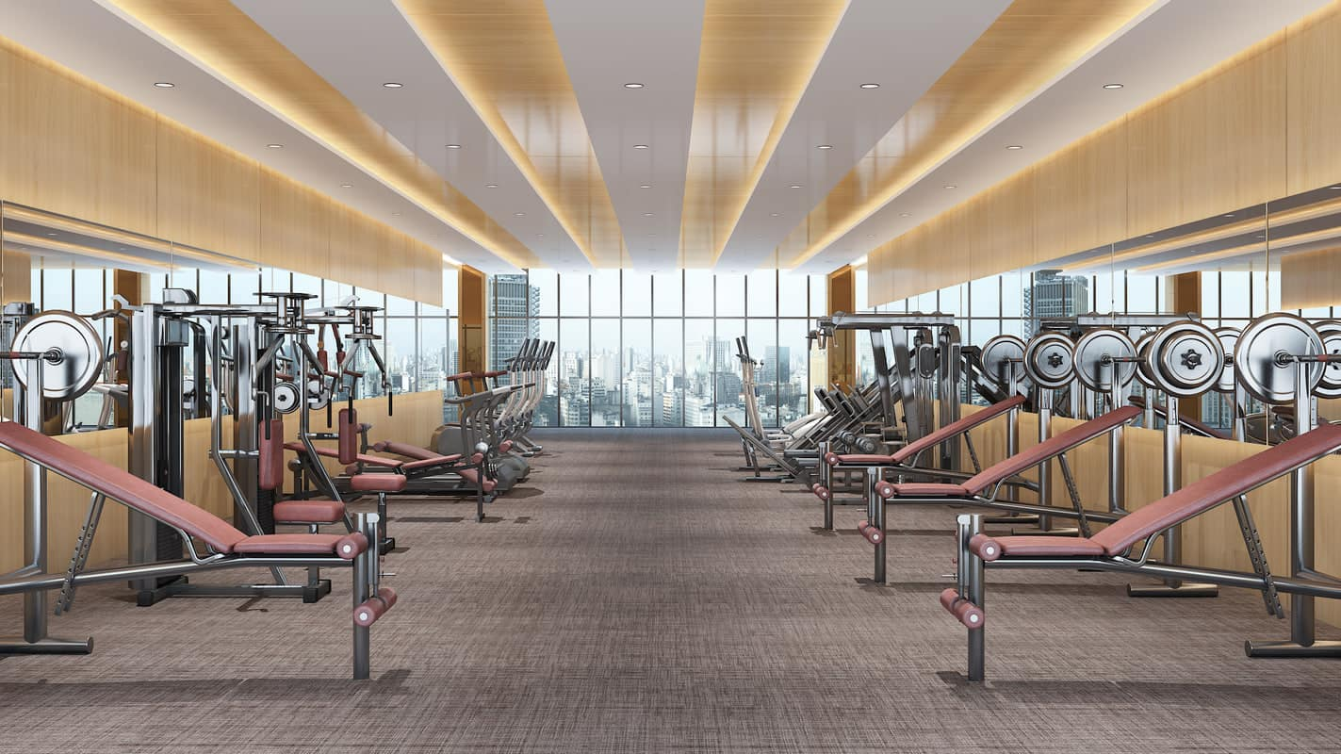
Fitness Survey
A short survey to assess the fitness routines of the minty floaters
By:
Aya
Malte
Filip

Slide 2
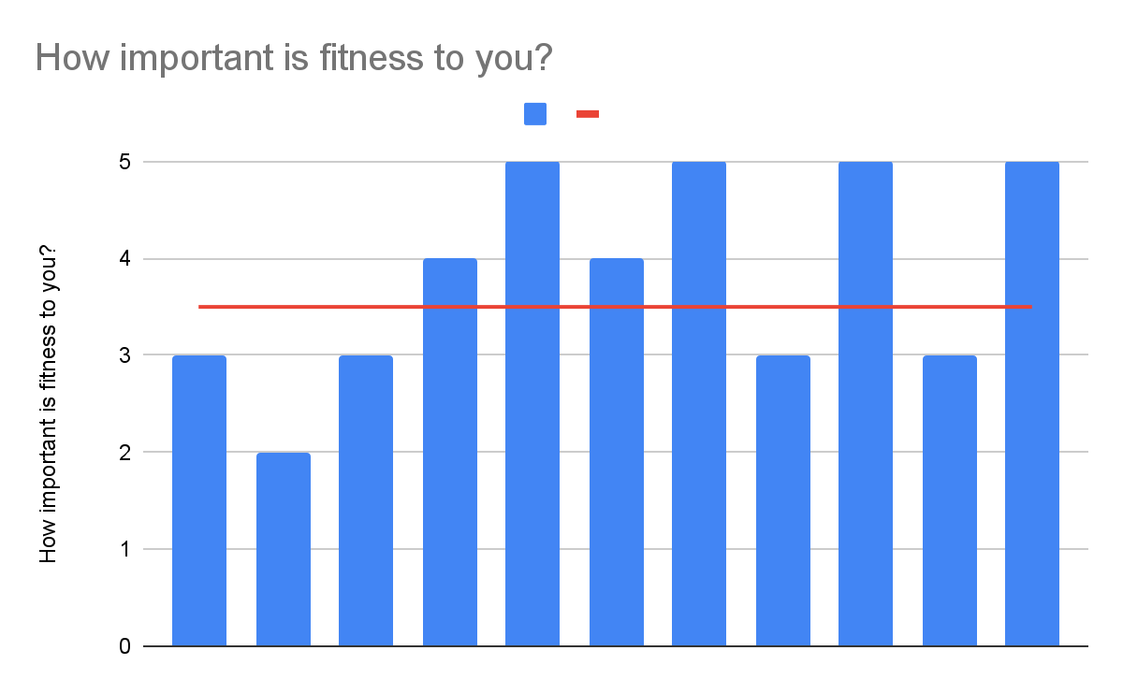
How important is fitness to you?
Rating
Mean: 3.7
Participants
Median: 3.5

Slide 3
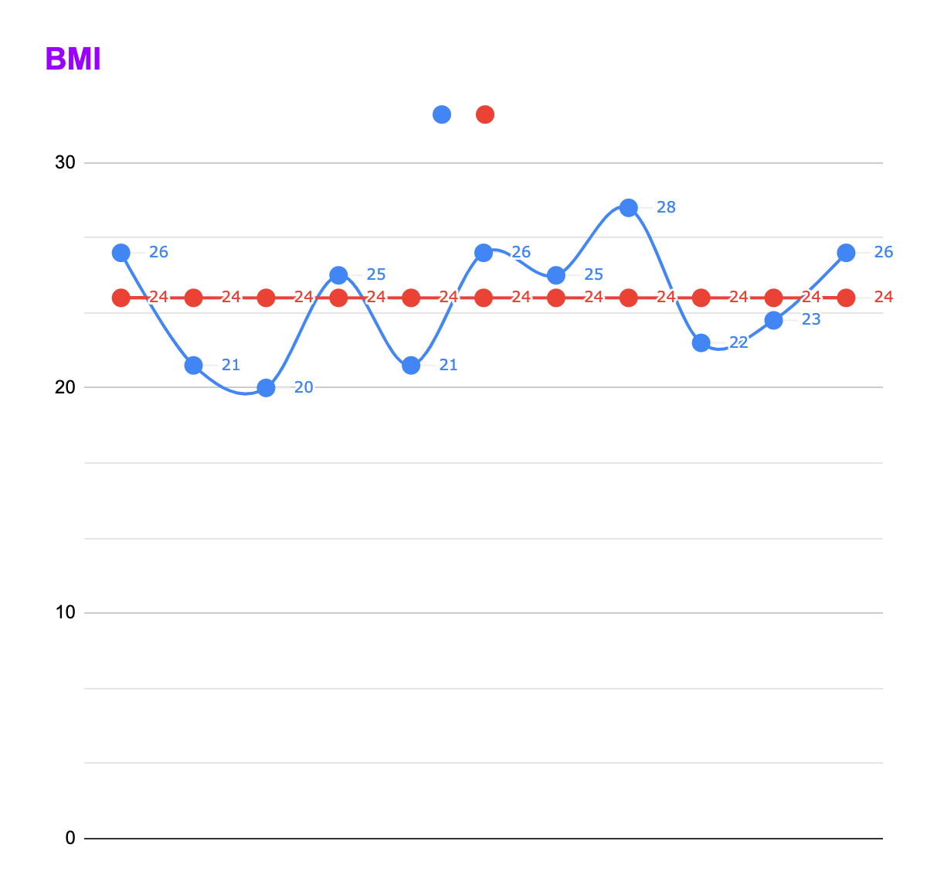
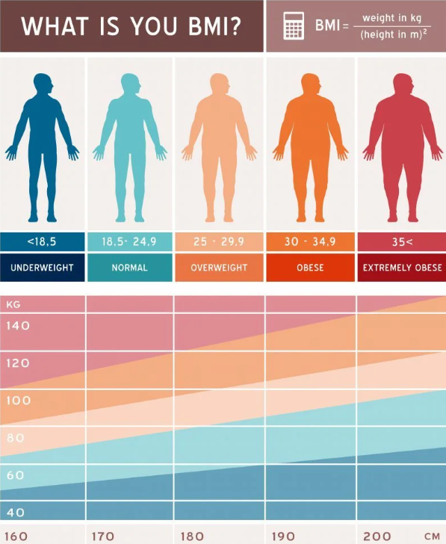
Body Mass Index
Mean: 24 kg/m²
Mode: 26 kg/m²
Standard deviation: 2.74 kg/m²

Slide 4
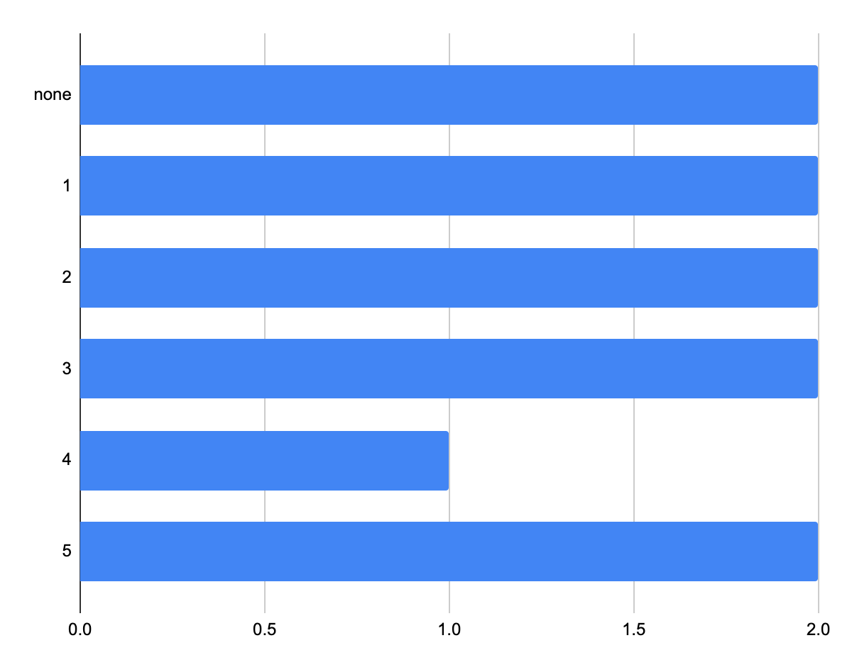
Exercise days a week
Days a week
Mean: 2.3 Days a week
Number of Participants

Slide 5
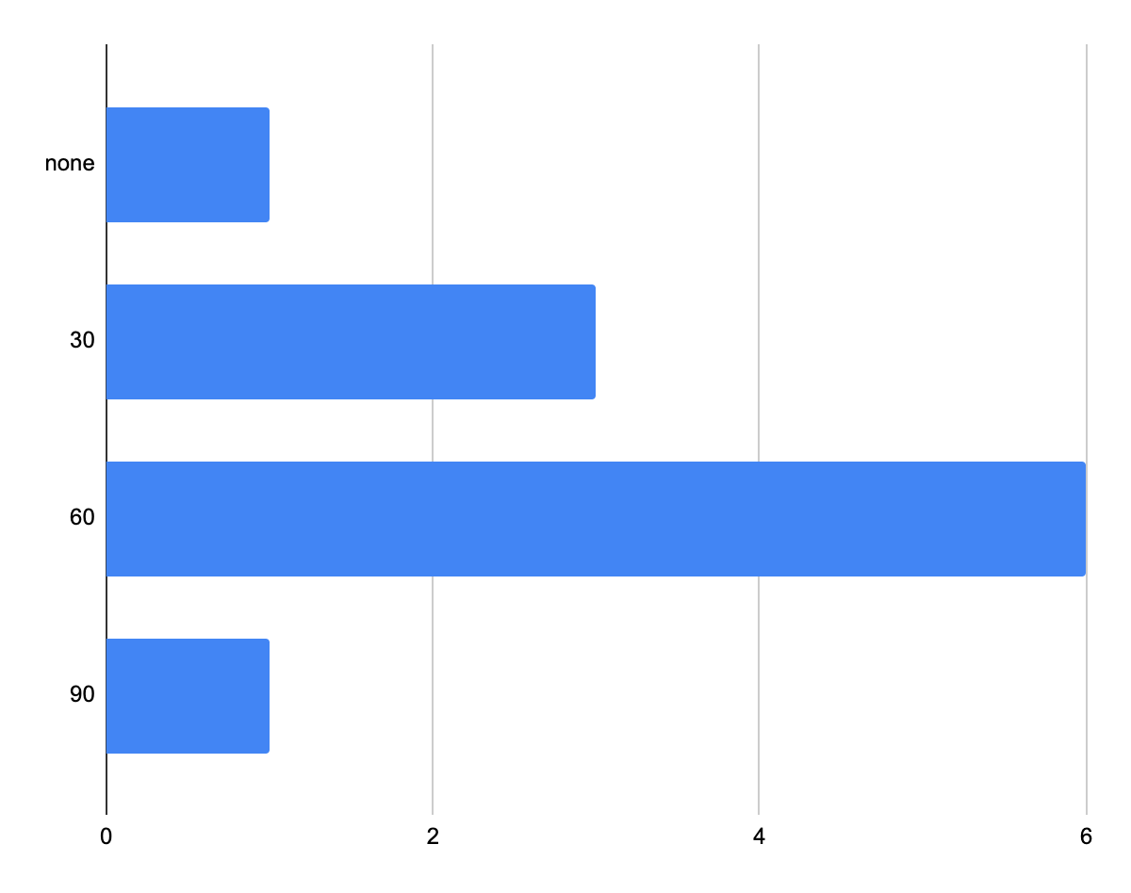
Exercise Duration
Duration of Exercise
Mean: 49 min
Mode: 60 min
Number of Participants

Slide 6
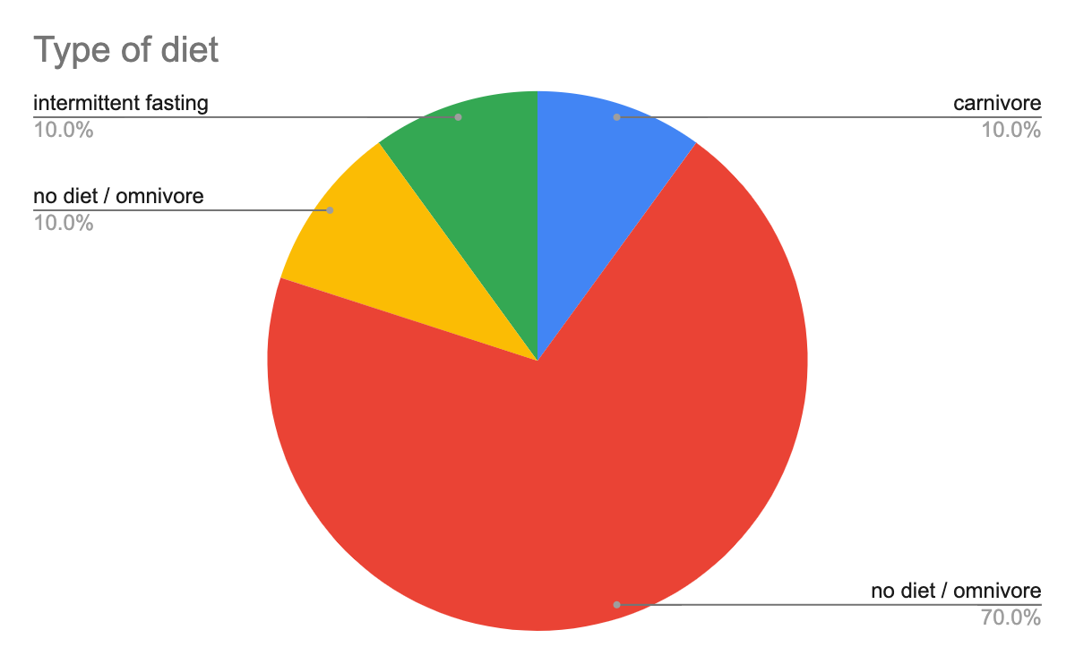
Type of Diet

Slide 7
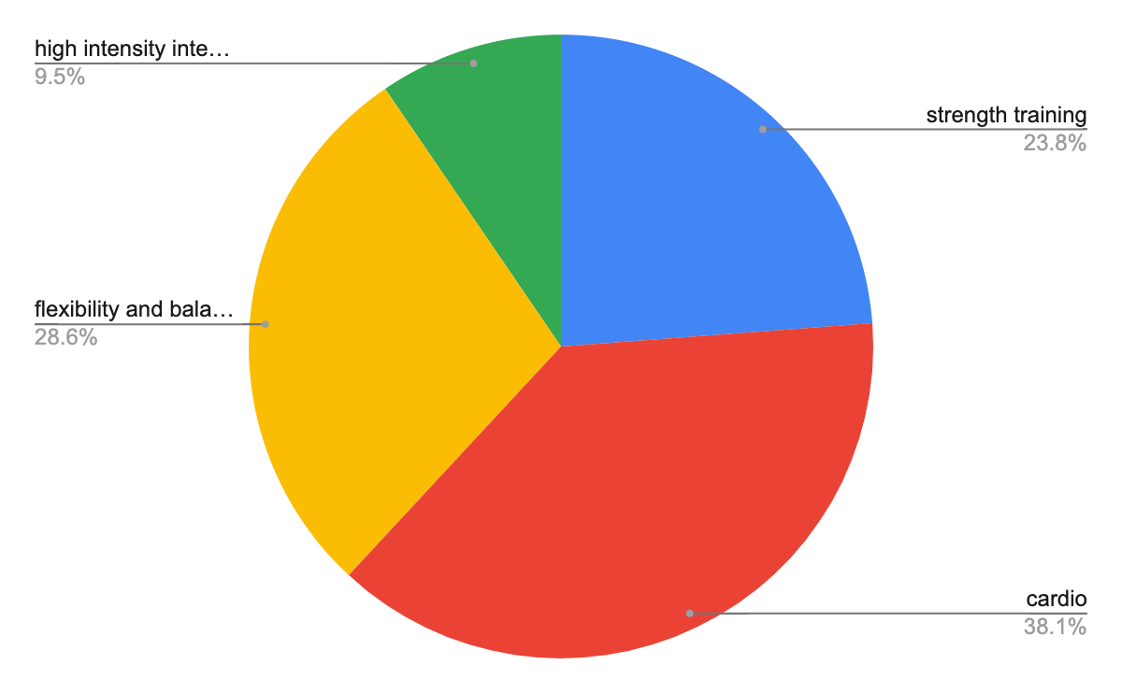
Type of Exercise

Slide 8
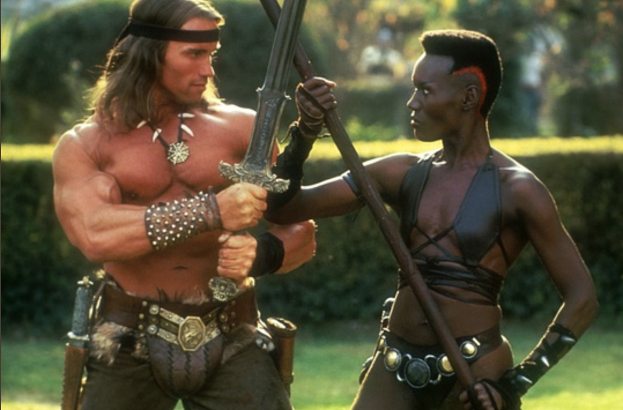
Thank you for your attention & stay fit and healthy ( because we are doing a follow up check at the end of the course ;)

